Slide 1
AutoCad 2021
د. وميض تركي محمد

Slide 2
في نهاية هذا الدرس يستطيع الطالب أن يتعرف على:
بداية رسم جديد Starting a New Drawing
التعامل مع ملفات البرنامجWorking with A.Cad files
استخدام المجموعة الاولى من ادوات الرسم Use the 1st group of drawing tools
رسم شكل شكل بسيط ثنائي الأبعاد Draw simple 2D shape

Slide 3
بداية رسم جديد Starting a New Drawing
Get started select template
Click New on:
Quick Access toolbar
Application Menu
1
2
3

Slide 4
بداية رسم جديد Starting a New Drawing
2
3

Slide 5
التعامل مع ملفات البرنامج Dealing with A.cad files
L.Click Application Menu
Open
Save As
Import
Export

Slide 6
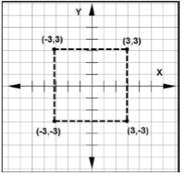
أدوات الرسم Drawing tools
Line: You can draw a line by specifying its start point and end point using the Line tool. However, there are various methods to specify start and end points of a line.
1. Using the Absolute Coordinate System
In this system, you specify the points with respect to the origin (0,0). A point will be specified by entering its X and Y coordinates separated by a comma, as shown in figure below.

Slide 7
أدوات الرسم Drawing tools
Line: You can draw a line by specifying its start point and end point using the Line tool. However, there are various methods to specify start and end points of a line.
Specify first point: Type 50,50 and press ENTER.
Specify next point or [Undo]: Type 150,50 and press ENTER.
Specify next point or [Undo]: Type 150,100 and press ENTER.
Specify next point or [Close Undo]: Type 50,100 and press ENTER.
Specify next point or [Close Undo]: press ENTER.

Slide 8
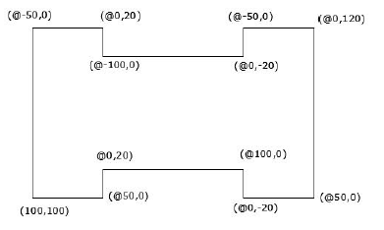
أدوات الرسم Drawing tools
2. Using Relative Coordinate system
Specify first point: Type 100,100 and press ENTER.
Specify next point or [Undo]: Type @50,0 and press ENTER.
Specify next point or [Undo]: Type @0,20 and press ENTER.
Specify next point or [Close Undo]: Type @100,0 and press ENTER.
Specify next point or [Close Undo]: Type @0, -20 and press ENTER.
Specify next point or [Close Undo]: Type @50,0 and press ENTER.
Specify next point or [Close Undo]: Type @0,120 and press ENTER.
Specify next point or [Close Undo]: Type @-50,0 and press ENTER.
Specify next point or [Close Undo]: Type @0,-20 and press ENTER.
Specify next point or [Close Undo]: Type @-100,0 and press ENTER.
Specify next point or [Close Undo]: Type @0,20 and press ENTER.
Specify next point or [Close Undo]: Type @-50,0 and press ENTER.
Specify next point or [Close Undo]: Select the Close option.
@0,-120 , and press ENTER

Slide 9
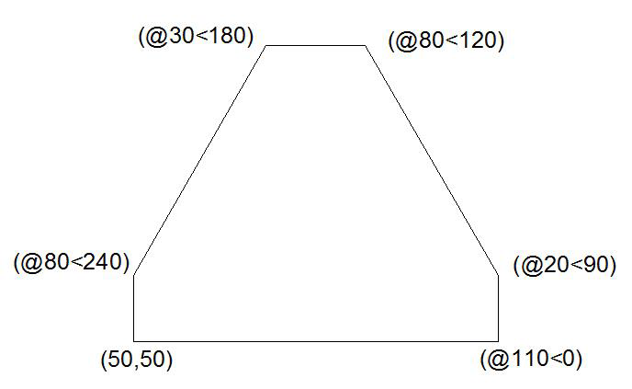
أدوات الرسم Drawing tools
3. Using Polar Coordinate system
Specify first point: Type 50,50 and press Enter key
Specify next point or [Undo]: Type @110<0 and press ENTER.
Specify next point or [Undo]: Type @20<90 and press ENTER.
Specify next point or [Close Undo]: Type @80<120 and press ENTER.
Specify next point or [Close Undo]: Type @30<180 and press ENTER.
Specify next point or [Close Undo]: Type @80<240 and press ENTER.
Specify next point or [Close Undo]: Type @20<270 and press ENTER
Specify next point or [Close Undo]: Select the Close option.

Slide 10
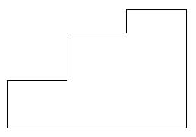
أدوات الرسم Drawing tools
3. Using Direct Distance Entry
Specify the first point of the line by typing 50,50 and pressing ENTER.
• Move the cursor horizontally toward right and type 150 as length.Next, press ENTER.
• Move the cursor vertically upwards and type 100 as length. Next, press ENTER.
• Move the cursor horizontally toward left and type 50. Next, press ENTER.
• Move the cursor vertically downwards and type 20. Next, press ENTER.
• Move the cursor horizontally toward left and type 50. Next, press ENTER.
• Move the cursor vertically downwards and type 40. Next, press ENTER.
• Move the cursor horizontally toward left and type 50. Next, press ENTER.

Slide 11
أدوات الرسم Drawing tools
Circle
center point for circle or [3P 2P Ttr (tan tan radius)]:10,10
Specify center of circle or[Diameter]:2

Slide 12
الدرس القادم ... AutoCAD 2021
في الدرس القادم ... سنكمل ما تبقى من أدوات الرسم... بإذن الله
شكراً جزيلا

